Slide 1

Build a Machine Learning Supercomputer under $500
Brian Korzynski
Code PaLOUsa 2018

Slide 2
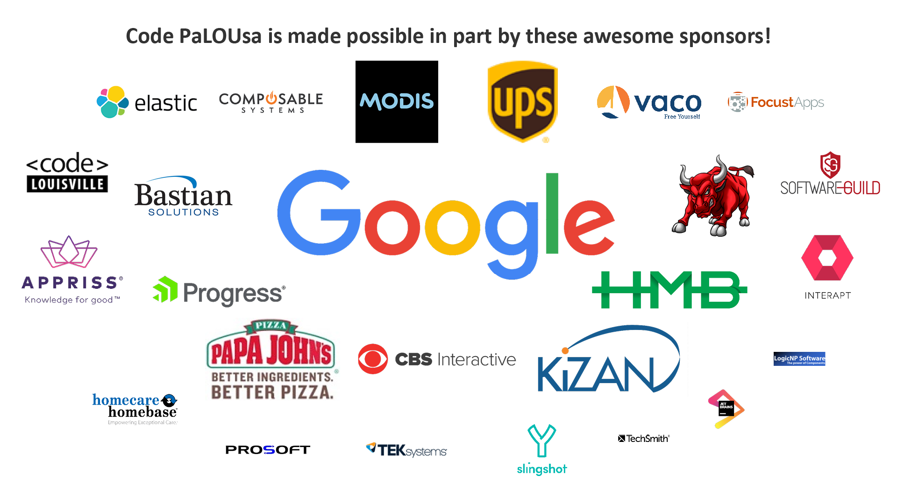

Slide 3
About Me
Senior Architect
Professional Developer for 9+ years
Windows Forms
Web
Mobile
SQL Optimization
Data Analysis
Mathematics
Big Data
Cloud
Machine Learning

Slide 4
The Problem
Be able to classify mortgage documents
E.g. loan application vs. bank statement

Slide 5
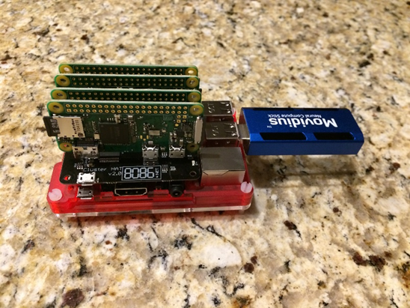
The Need
Needed the ability to test different ML algorithms for a.) Performance b.) Load Balancing and c.) Distributability
Wanted dedicated hardware so that I can get more accurate metrics
Occupied a very small footprint since my desk isn’t big enough for another computer
Flexibility so I can reconfigure it (hardware and software)
Cheap

Slide 6

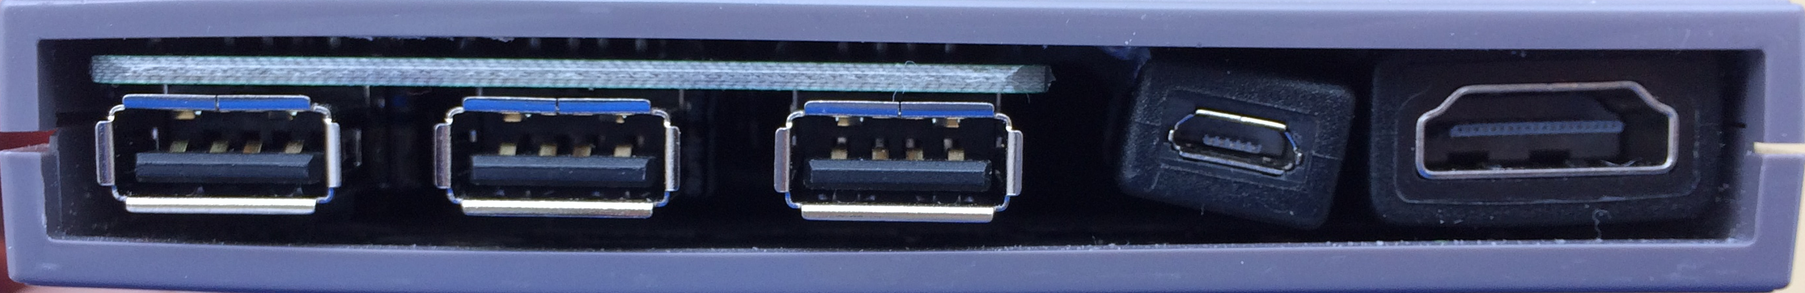
Why Raspberry Pi?
Have always wanted to mess around with this type of technology but didn’t know what to build
A friend of mine told me about RetroPi

Slide 7
Why Raspberry Pi?
Mature platform (both hardware and software)
Easy to get started
Very cheap compare to a lot of its competitors
Tons of flexibility (configurations, add ons, software, etc.)
Very Small footprint
Huge community for when I get stuck
Partnership with Movidius (more on this later)

Slide 8
Why Cluster?
Wanted to be able to test different distributed scenarios of my algorithms and this is the easiest way to do that
There are many different designs for clusters, however today we will only look at a few of the most common

Slide 9
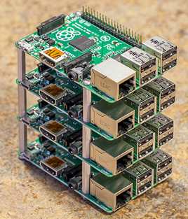
Types of Clusters – Model B
Pros
More powerful than other cluster designs such as (Zero W Cluster)
Each node can have dedicated ethernet
Ability to add and remove nodes without taking the entire cluster down
Cons
More Expensive
Larger space requirement (vertically)
A lot more cables to connect everything
May require additional hardware such as router and a USB hub
Notes:
https://www.raspberrypi.org/forums/viewtopic.php?t=83141

Slide 10
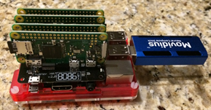
Types of Clusters – Zero W
Pros
Cost (Zero W nodes are $5 each, Model B nodes are $35 each)
Much more compact design (smaller footprint)
Using the ClusterHAT they have taken care of the work to setup the cluster
Single Power Cord for entire system
Cons
Not as fast in raw performance compared to the Model B cluster

Slide 11
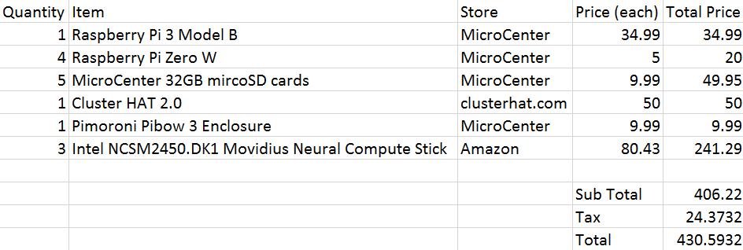
My Hardware Cost

Slide 12
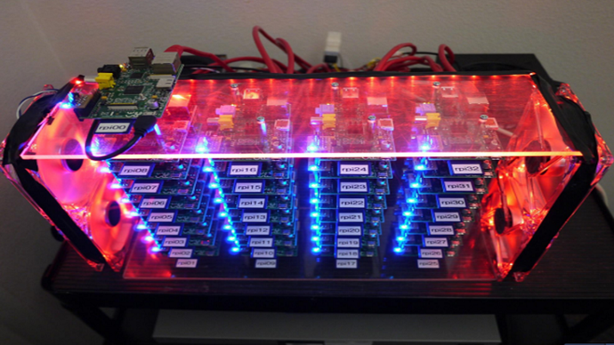
Extreme Cluster
Notes:
https://www.techworm.net/2018/03/learn-build-supercomputer-raspberry-pi-3-cluster.html

Slide 13
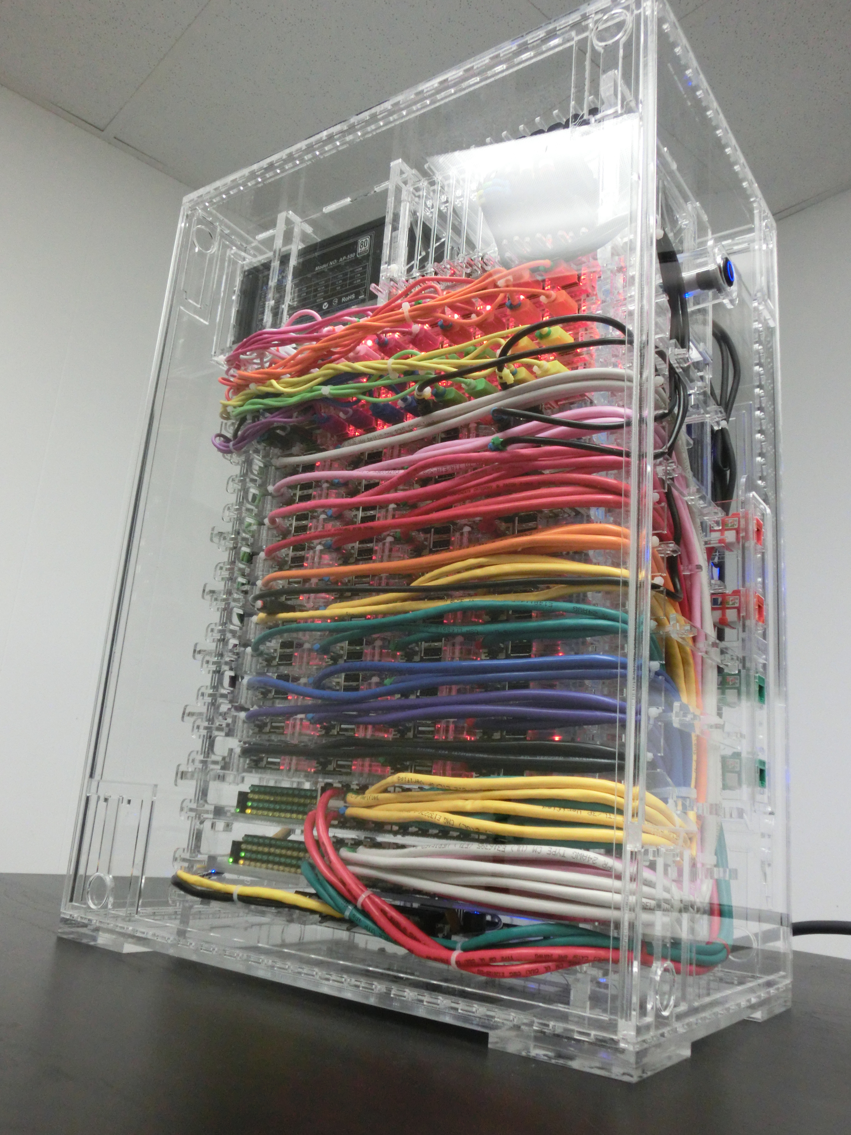
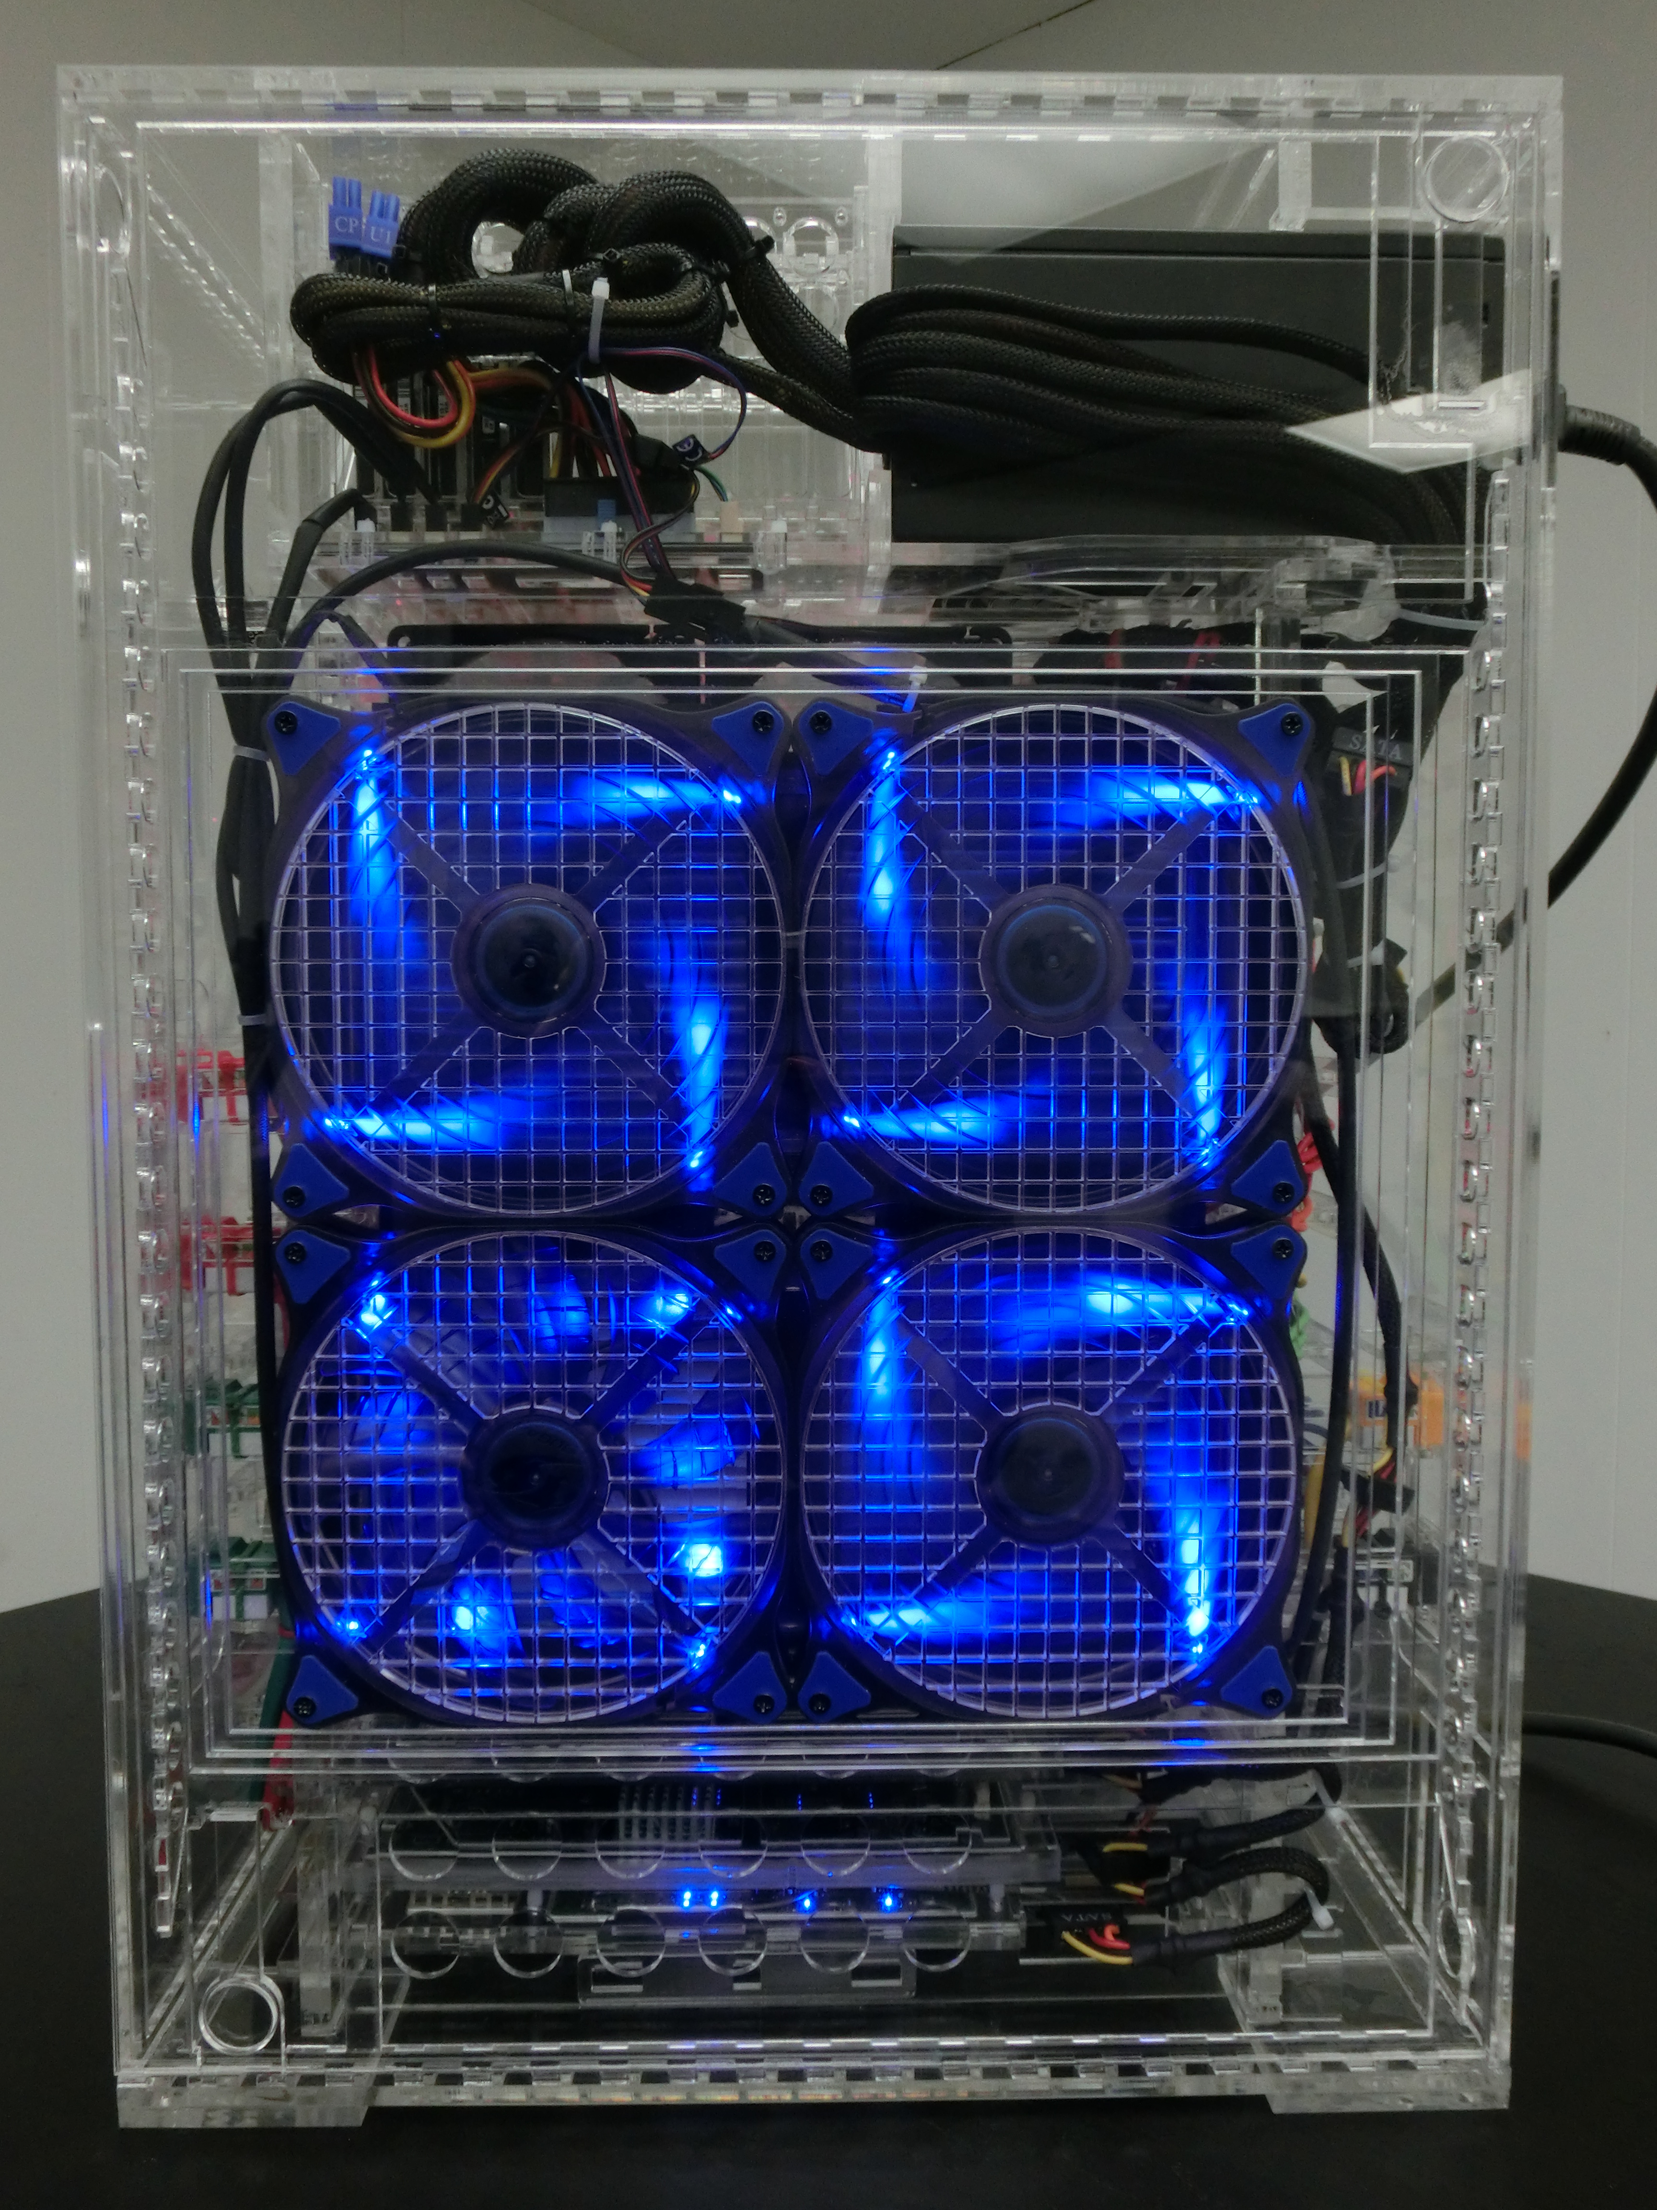
Extreme Custer 2
Notes:
http://likemagicappears.com/site-content/uploads/2014/02/RPCI-00-00000007.jpg
http://likemagicappears.com/site-content/uploads/2014/02/RPCI-00-00000012.jpg

Slide 14
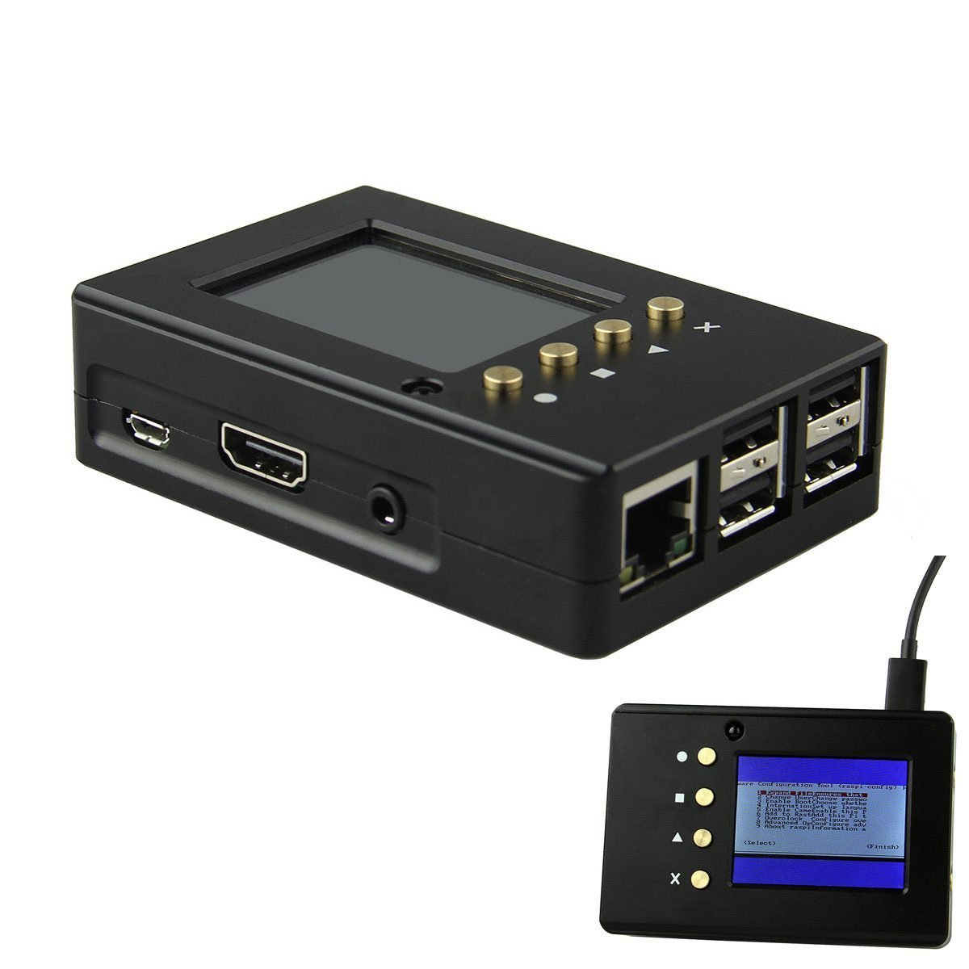
Options – Other Case
Raspberry PI 3 Model B Case
Pros
Aluminum Case
Includes 2.2” screen
Integrated buttons
Cons
Screen is too small to use for basic computing
Cost (Amazon $42) more expensive than the Raspberry Pi
Notes:
https://www.amazon.com/gp/product/B06XGG28CW/ref=ox_sc_act_title_4?smid=A26ATEC08S9EFM&psc=1

Slide 15
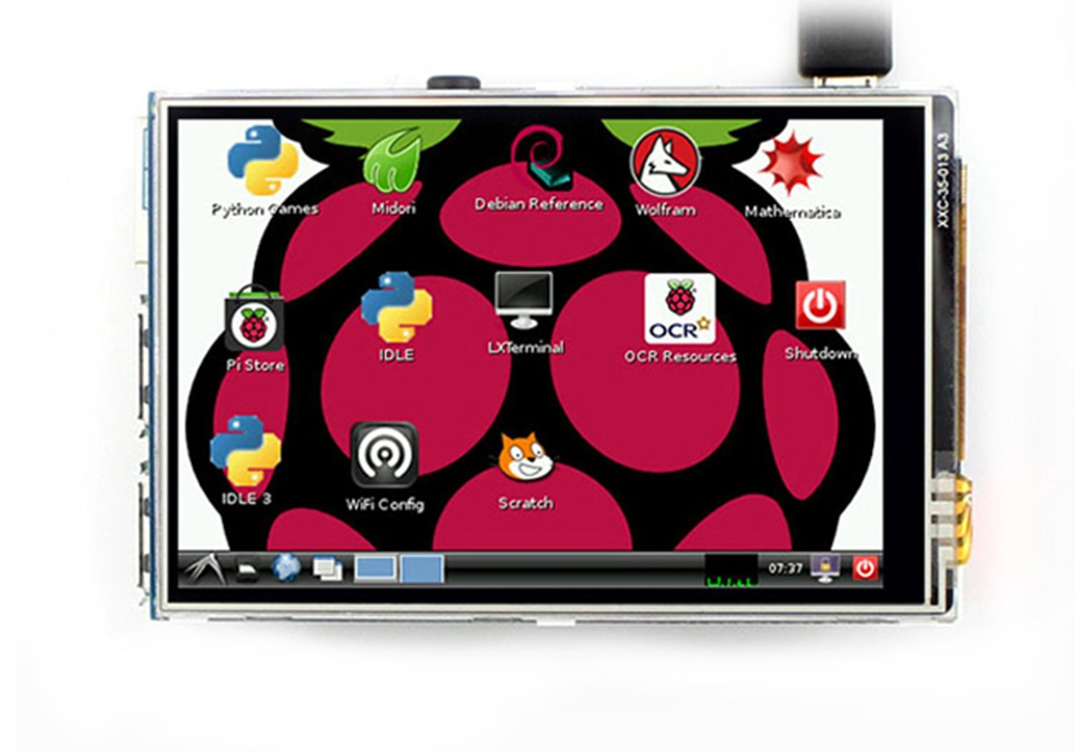
Options - Screens
3.5” Touch Screen
Pros
Cheap (Amazon $16.88)
Easy to Setup (with the correct instructions)
Works really well
Cons
Size is almost too small to use as a standalone computer (it is better for a app specific display)
Notes:
https://www.amazon.com/gp/product/B01IGBDT02/ref=od_aui_detailpages02?ie=UTF8&psc=1

Slide 16
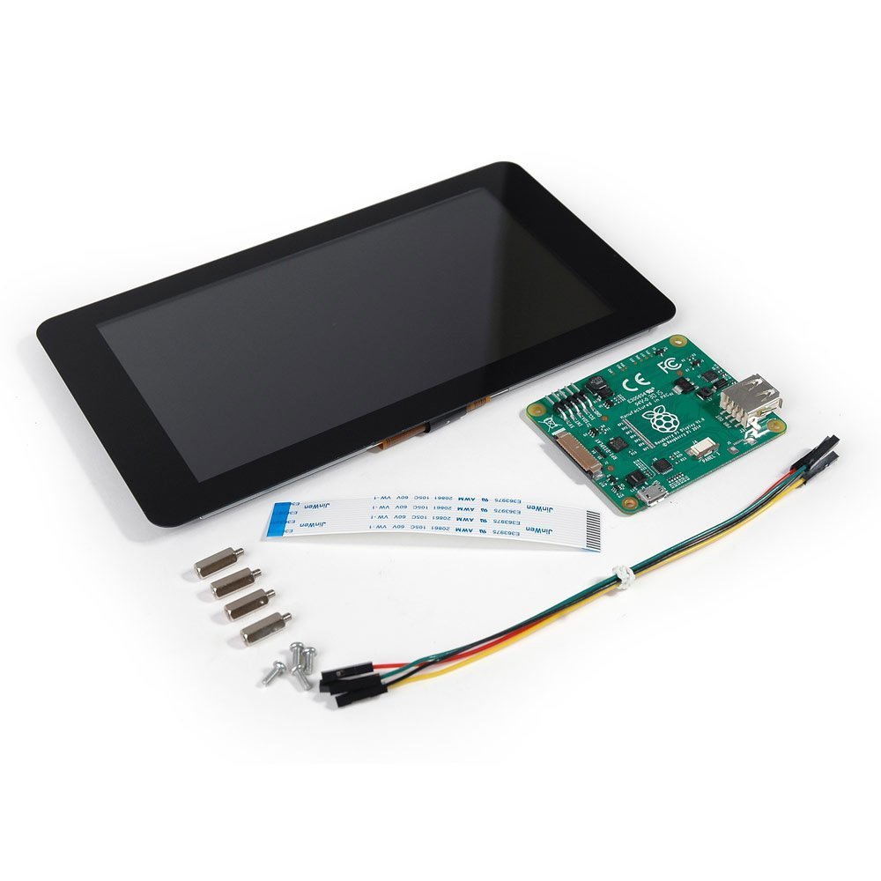
Options - Screens
7” Touch Screen
Pros
Larger screen size
Can be used as a computer screen, not just app specific
Using with a case can encapsulate the entire system
Cons
Twice as expensive as the Raspberry Pi (Amazon $75)
Should put in a case which is another $15
Notes:
https://www.amazon.com/gp/product/B0153R2A9I/ref=ox_sc_sfl_title_2?ie=UTF8&psc=1&smid=A30C3BNH6KK26G

Slide 17
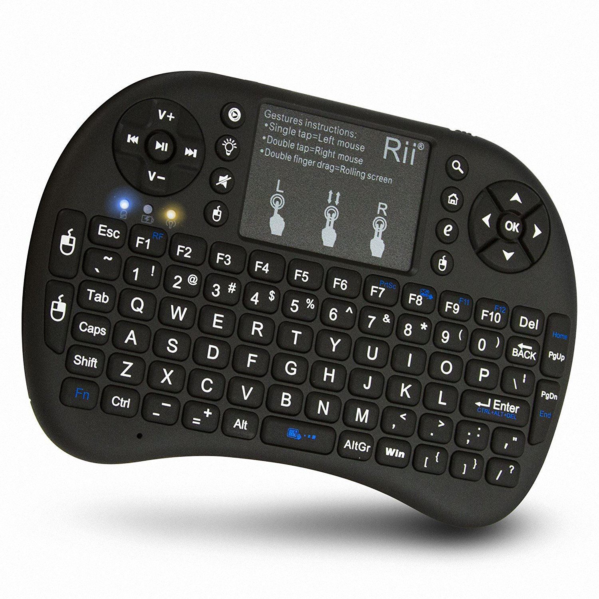
Options – Keyboard & Mouse
Wireless Keyboard and TouchPad
Pros
Cheap (Amazon $22)
Works with any Bluetooth device
Works Really Well
Very lightweight
Cons
Defaulted to UK English
Feels like plastic
Notes:
https://www.amazon.com/gp/product/B00Z81U3YY/ref=ox_sc_act_title_1?smid=A1JQNKX8H5YU3Y&psc=1

Slide 18
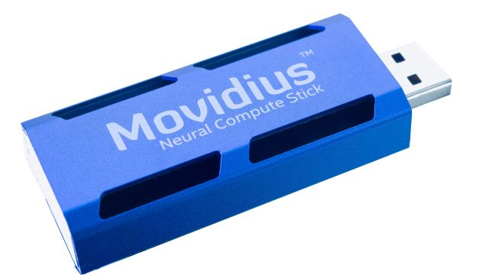
Movidius Neural Compute Stick
A special chip dedicated for AI work and Computer Vision work
Process Neural Network algorithms using TensorFlow or Caffe
Advantages
Can be clustered together
Disadvantages
Requires Linux (either Ubuntu VM or Raspberry Pi 3 Model B)
Notes:
https://www.tenettech.com/product/movidius-neural-compute-stick

Slide 19
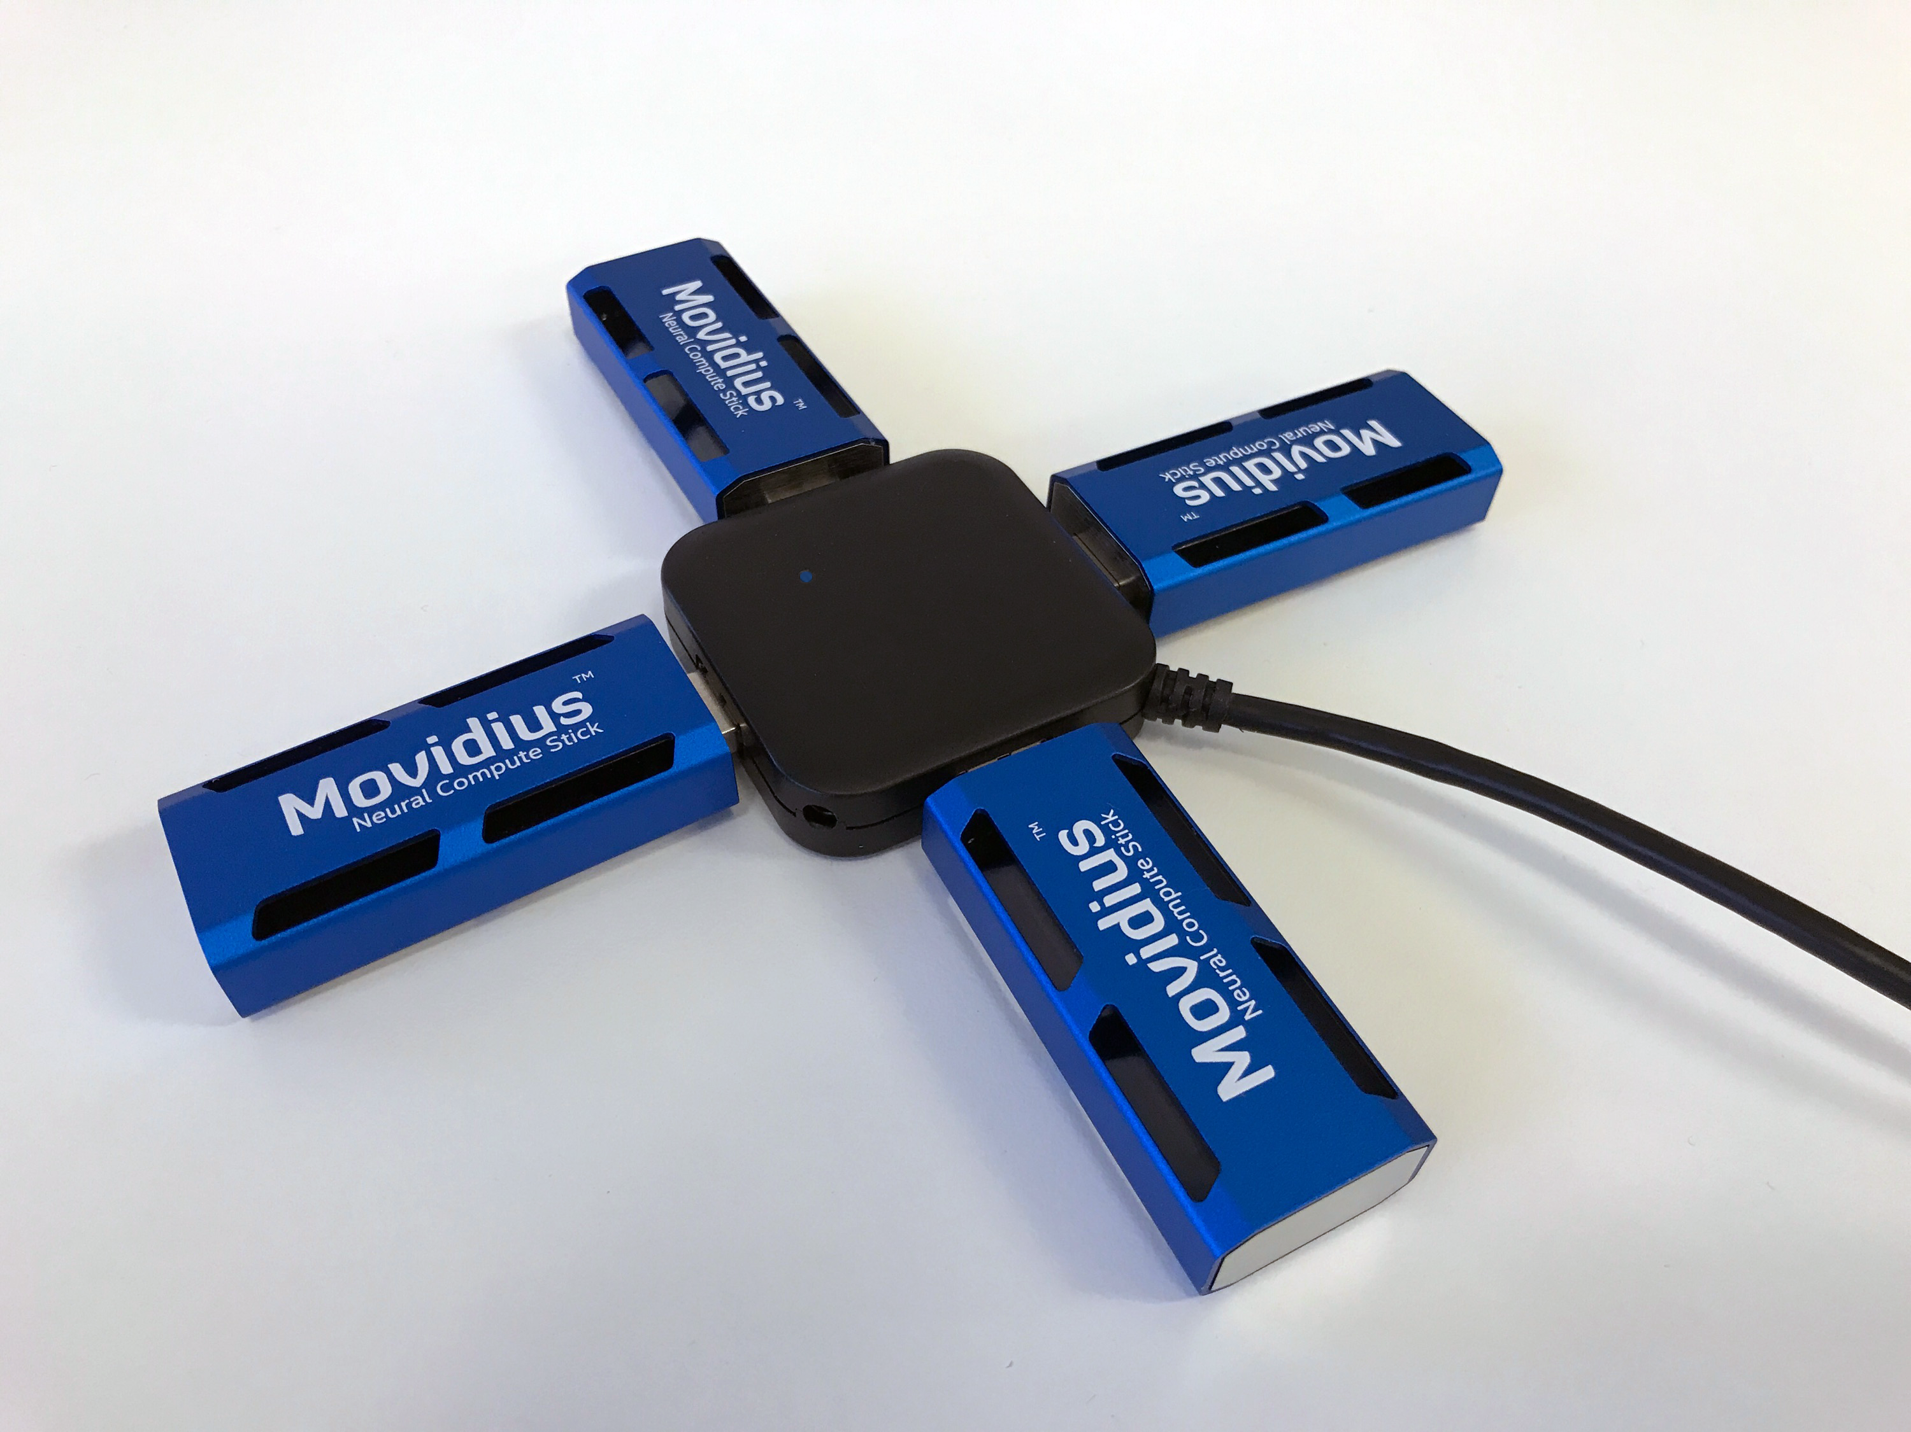
Movidius - Cluster
Notes:
https://cdn.vox-cdn.com/uploads/chorus_asset/file/8884109/Quad_USB_1400_1050.png

Slide 20
Movidius - Video
Notes:
https://www.youtube.com/watch?v=jMcrbhIa9EA

Slide 21
Movidius – Types of Problems
Really excels at the Visual based algorithms
Image Classification
Object Recognition
Can be used to solve any type of ML problem, works best with Neural Networks
“Deep Neural Network-based Classification” – Movidius

Slide 22
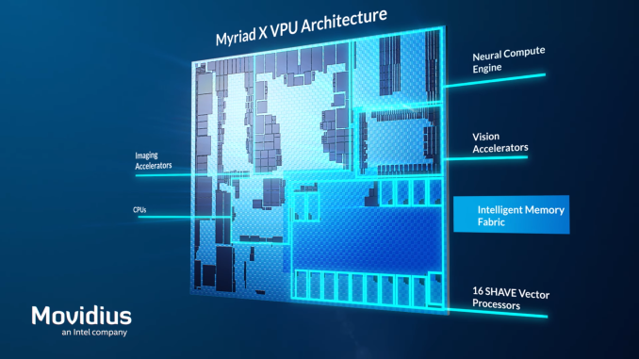
Movidius - Architecture
Notes:
https://www.extremetech.com/g00/computing/254772-new-movidius-myriad-x-vpu-packs-custom-neural-compute-engine?i10c.encReferrer=aHR0cHM6Ly93d3cuZ29vZ2xlLmNvbS8%3D&i10c.ua=1

Slide 23
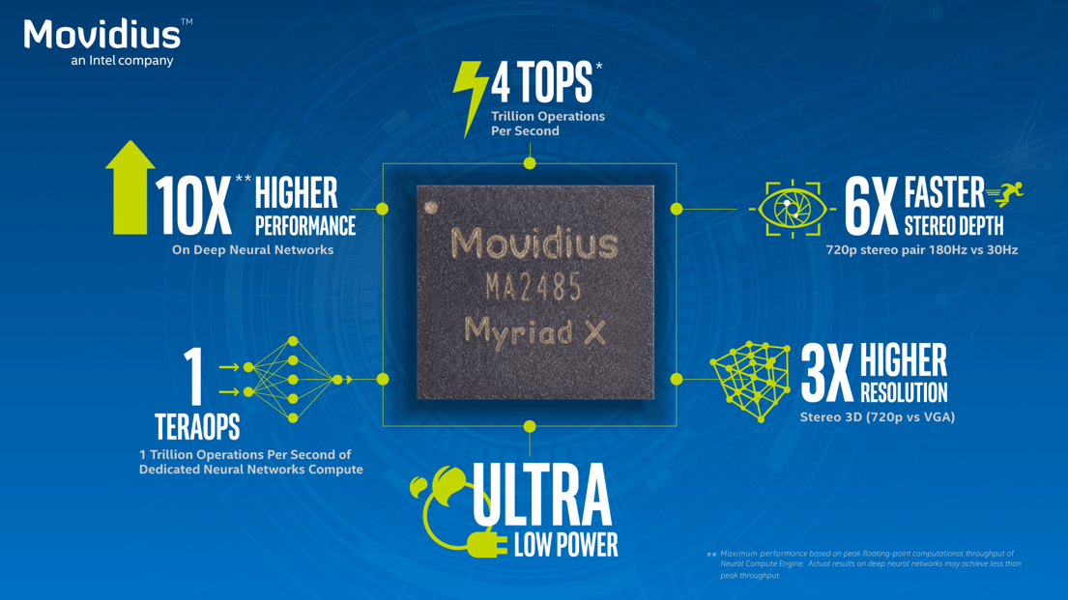
Movidius – The Next Generation
Notes:
https://www.google.com/imgres?imgurl=https%3A%2F%2Fmovidius-uploads.s3.amazonaws.com%2F1503930622-performance-comparisons_8_28.png&imgrefurl=https%3A%2F%2Fwww.movidius.com%2FMyriadX&docid=qobrfFTLH4QLtM&tbnid=wjAvlvhnfJloWM%3A&vet=10ahUKEwiFwI6zlcLaAhVC1lMKHQ4zAMYQMwhGKAgwCA..i&w=1024&h=576&bih=787&biw=719&q=movidius%20architecture&ved=0ahUKEwiFwI6zlcLaAhVC1lMKHQ4zAMYQMwhGKAgwCA&iact=mrc&uact=8

Slide 24
Programming Environment
Development Environment (desktop)
Windows
Visual Studio Code
Python
TensorFlow with GPU support
Neural Compute Stick (NCS) SDK
PuTTY
WinSCP
Simulation Environment
Raspberry Pi Zero W Cluster (with 3 Neural Compute Sticks)
Raspbian
Python
TensorFlow
Neural Compute Stick (NCS) SDK

Slide 25
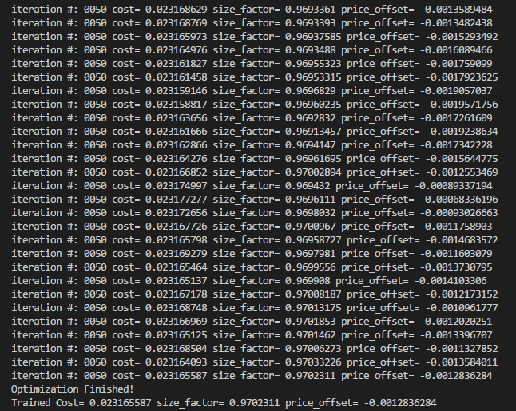
Demo – well sort of
App to predict housing prices based upon square footage
Show how Movidius performs on a non-visual ML problem
python app.py

Slide 26
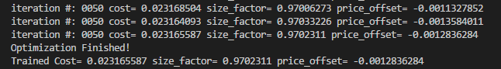
Demo – well sort of

Slide 27
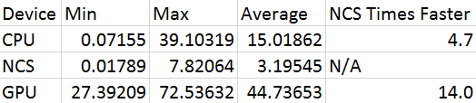
Demo - Performance
CPU
Intel Core i7-4770K @ 3.5GHz
177 GFLOPS
GPU
nVidia GeForce GTX 680
3250 GFLOPS
Movidius
150 GFLOPS
Capable of 1 TOPS

Slide 28
Next Things I want to Try
I want to build a Model B cluster to see if it improves performance
Different Algorithms against the Modivius
Computer Vision
Recurrent Neural Networks (e.g. text classification)
Convolutional Neural Networks (e.g. image classification)
Performance testing using multiple Movidius’
Getting real-time data from different sensors and making predictions based upon them, such as temperature, acceleration, and touch.
3D Printing a custom case

Slide 29
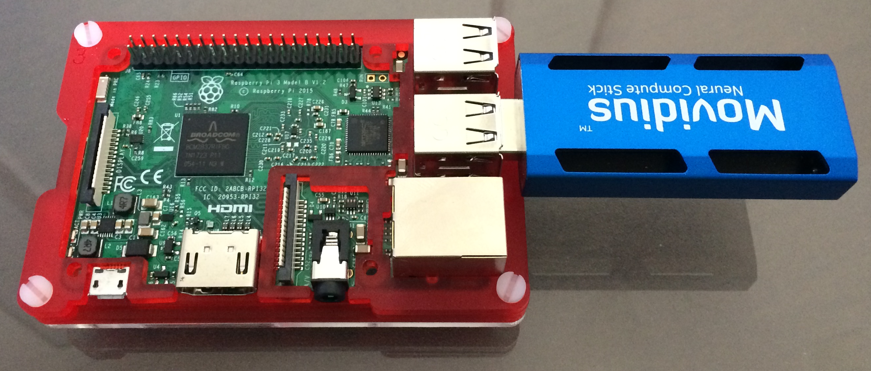
Base System
Raspberry Pi 3 Model B
Case
Memory Card
Neural Compute Stick
Cables

Slide 30
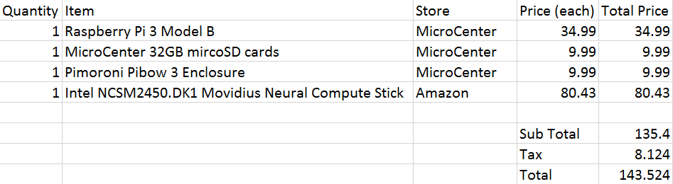
Base System Part Breakdown

Slide 31
Links
Raspberry Pi
http://raspberrypi.org
ClusterHAT
Overall - https://clusterhat.com/
Setup - https://clusterhat.com/setup-overview
Movidius
Video - https://www.youtube.com/watch?v=jMcrbhIa9EA
Getting Started - http://developer.movidius.com/start

Slide 32
Questions
github.com/korz
@bkorzynski

